Slide 1

The Network Module
This section will introduce you to the power flow solver for transmission networks.

Slide 2
What is the network module?
The network module is used to simulate a powerflow transmission network
The power flow algorithm used for the transmission system is the Gauss-Seidel (GS) method with a balanced three-phase positive sequence power flow.
The GS method can be more easily implemented using parallel processing systems

Slide 3
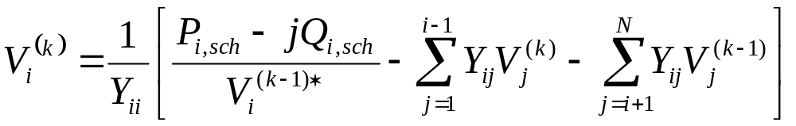
Gauss-Seidel Equations
V is the node voltage
i is the current node
k is the current iteration number;
Y_{ii} is the self admittance matrix
P_{i,sch} is the scheduled real power injection
Q_{i,sch} is the schedule reactive power injection
Y_{ij} is the admittance of the line connecting node i with the j node

Slide 4
How does it work?
Like the distribution network, the transmission network is looked at as a system of nodes and links
Iterations are repeated for each timestep until the system converges

Slide 5
Integration of powerflow module and network module
The transmission module allows interconnection of multiple distribution feeders.
The integration of these two modules makes examining how “smart loads” on the distribution system affect the transmission system possible.
Integration via the substation object (in powerflow)
Due to the nature of powerflow and network, specify module for similar names
(e.g., object powerflow.node {)

Slide 6
Integration of powerflow module and network module
object substation {
/* inherits from powerflow.node */
double Network_Node_Base_Power;
double Network_Node_Base_Voltage;
}
Translates positive sequence network voltage into swing bus balanced three-phase voltage for distribution
Power on all three phases of distribution summed and divided by three and posted as a load to network node

Slide 7
Objects in Network Module
Similar to powerflow module
  Capacitor bank
  Fuse
  Link
  Meter
  Node
  Regulator
  Relay
  Transformer
Does not include configuration objects
Contains Generator object

Slide 8
Network Input
Multiple input methods
  GLM file
  Import IEEE test systems in common data format (CDF file)
import network IEEE14.cdf;

Slide 9
Network Output
Voltage and power at each node
Current and Admittance at each link
Log of events (Debug if specified)

Slide 10
Sample Network Output
Node Object
Name | V | S | G | B | Qmax_MVAR | Qmin_MVAR | type | flow_area_num | base_kV
Bus 1 HV (#0) | +1.06+0d | +2.2379-0.0838855j | +0 | +0 | +0 | +0 | SWING | 1 | +0
Link Object
Name | Y | I | B | from | to
(link:14) (#14) | +4.99913-15.2631j | +1.43907+6.14206d | +0.0528 | Bus 1 HV | Bus 2 HV

Slide 11
Exercises
Load a simple 4-bus system
Load the14-bus IEEE system
Integrate a transmission system and distribution system using a substation object

